Slide 1

21AIE112 ELEMENTS OF COMPUTING SYTEMS
Under the Guidance of: Ms MEENA BELWAL

Slide 2
JACK BIRD
PRESENTED BY:
BL.EN.U4AIE21072-M.RAMYA SREE
BL.EN.U4AIE21080-M.SIDDHARTHA
BL.EN.U4AIE21101-P. VAMSI VARDHAN REDDY

Slide 3
TABLE OF CONTENTS
Introduction
JACK Language
JACK Data types
Game Operations
Folder
Output
Future Scope
Conclusion

Slide 4
INTRODUCTION
Playing games is fun and exciting. It gives us relief from stress and unwinds from our stressful work. With the help of jack language, we have implemented a game that is jack bird.
Jack Bird is an interesting single player game where the player controls a bird, attempting to fly between the columns without hitting them. If the bird touches the columns, top and bottom part of screen game ends and player loses the game. In our Implementation we intend to make this a single player game where, the bird is controlled with the help of the keybinds.

Slide 5
JACK Language
A Jack program is a collection of one or more Jack classes, one of which must be named Main
The Main class must have at least one function, named main
Program’s entry point: Main.jack

Slide 6
JACK Data types
Primitive :
int
Char
Boolean
Class Types :
OS : String

Slide 7
Game Operation
Press ‘Spacebar’ key to start the game
Use ‘Spacebar’ to control the bird: If you press spacebar then bird goes up or else it falls down.
Use ‘Q’ key to quit the game.

Slide 8
What Classes We Have Used To Implement The Game ?
FlappyBird- Models the FlappyBird object and creates/updates the bird image.
FlappyBirdGame- Models the Flappy Bird game at a high level by creating in-game objects, handling user inputs, and moving through game states.
Main- It intialises the game and start running it
MyMath- Modulus operator function.
Pipe- Models an individual Pipe object and creates/updates the pipe image.
ScoreBoard- Displays scoreboard with designated score.

Slide 9
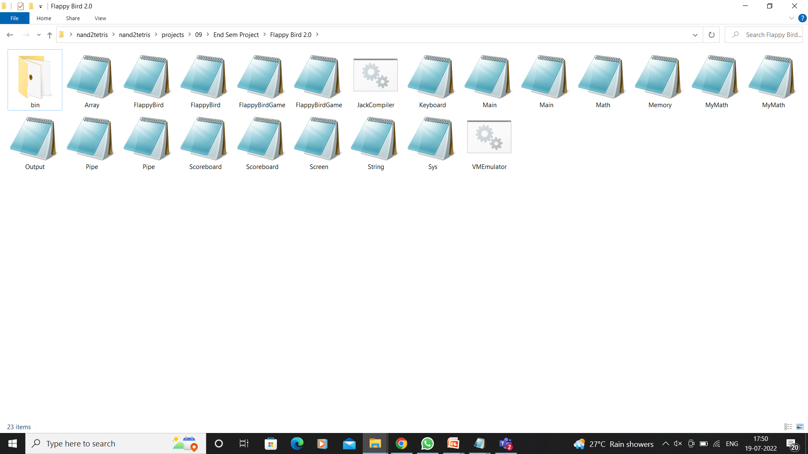
Folder:

Slide 10
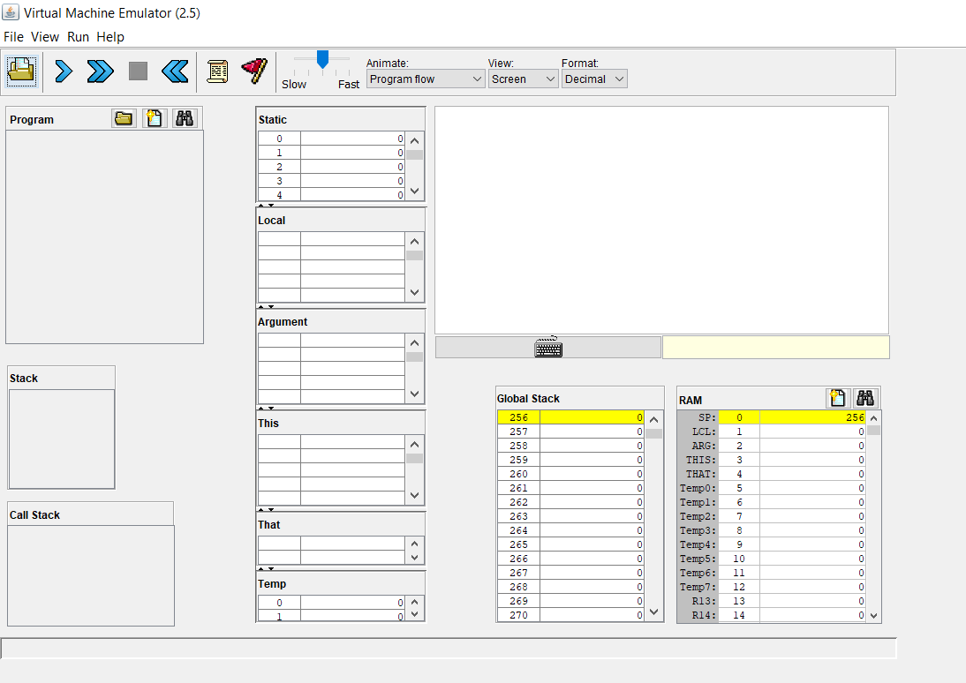
Output:

Slide 11
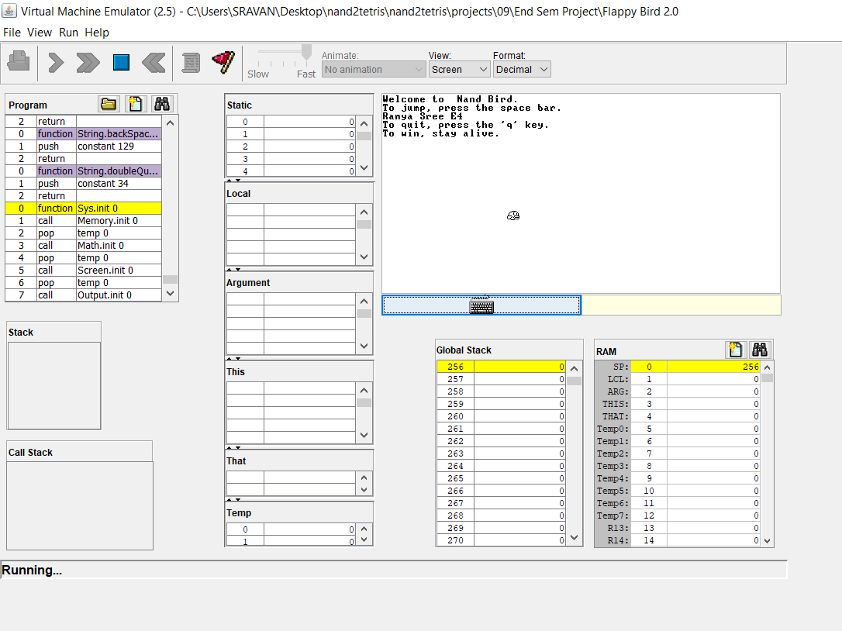

Slide 12
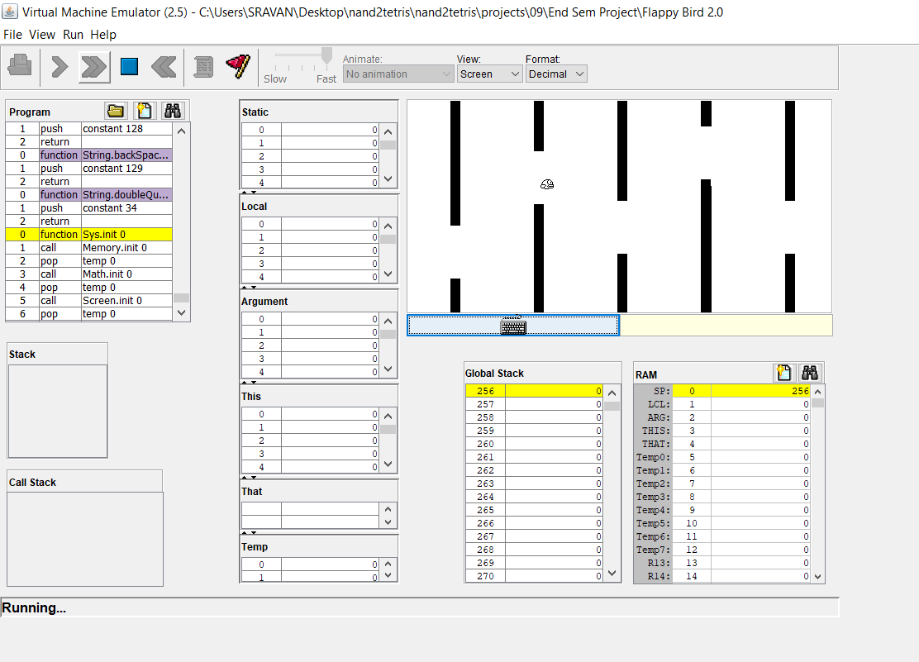

Slide 13
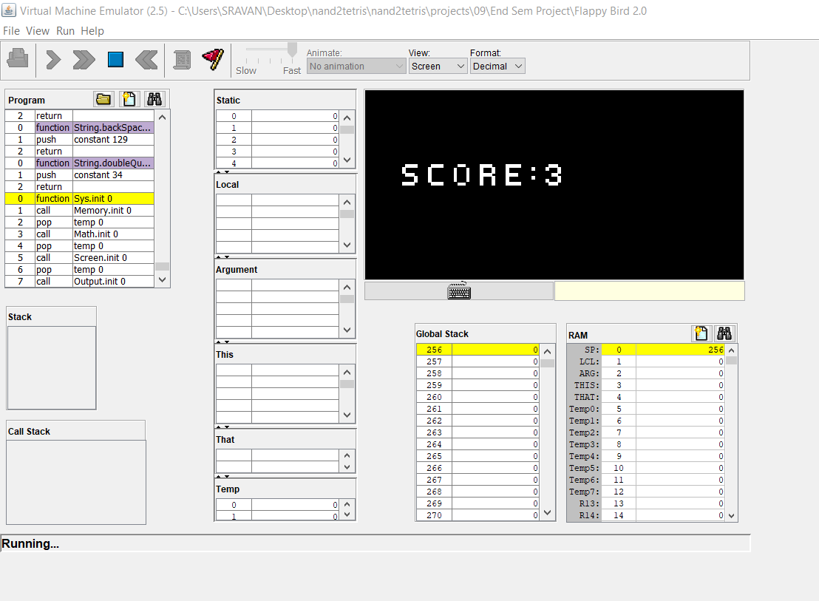

Slide 14
FUTURE SCOPE
We can make it more user-friendly.
We can add more options like top score and players’ profiles.
We can add other obstacles.
We can add a multiplayer option.

Slide 15
CONCLUSION
This project is done in JACK programming. In this project, you can play the popular “ Jack Bird” just like you played it elsewhere.
You have to use the Spacebar to control the bird. The code was written in jack language and it was compiled using jack compiler which converts jack file into VM file. The final simulation was done in a VM emulator where we can play the game.

Slide 16
Thank You

